Slide 1
Short Term Forecasting with Support Vector Machines and Application to stock price prediction
Huseyin Ince and Theodore B. Trafalis
Faculty of Business Administration, Gebze Institute of Technology, Gebze, Kocaeli, Turkey;
School of Industrial Engineering, University of Oklahoma, Norman, OK, USA
Presenter: Tsung-Jung Tsai (蔡宗容)
Date: April 23, 2008

Slide 2
Abstract (1/2)
Forecasting a stock price movement is one of the most difficult problems in finance. The reason is that financial time series are complex, non stationary(非定性、非定態). Furthermore, it is also very difficult to predict this movement with parametric models(母數模型). Instead of parametric models, we propose two techniques, which are data driven and non parametric(無母數、非參數). Based on the idea that excess returns(超額報酬) would be possible with publicly available information, we developed two models in order to forecast the short term price movements by using technical indicators(技術指標).

Slide 3
Abstract (1/2)
Our assumption is that the future value of a stock price depends on the financial indicators although there is no parametric model to explain this relationship. This relationship comes from the technical analysis. Comparison shows that support vector regression (SVR，支持向量回歸) outperforms the multi layer perceptron (MLP，多層感知器) networks for a short term prediction in terms of the mean square error. If the risk premium(風險溢酬) is used as a comparison criterion, then the SVR technique is as good as the MLP method or better.

Slide 4
Comparison between financial and information engineering
資訊工程
  Algorithm (演算法)
  把時間複雜度降到最低
  準確度最大化
  模型
    同源模擬法
    重頭起算法(AB initio)
  背景知識
    數學
    電腦科學
    分子生物學
財務工程
  Strategy (策略)
  把報酬率最大化
  風險最小化
  模型
    無母數模型
    母數模型
  背景知識
    電腦科學
    數學、統計
    財務理論
Notes:
●同源模擬法(Homology modeling)：將未知的目標序列跟蛋白質結構資料庫(PDB)作序列比對，來尋找出最好的模板(Template)，以此模板為模型將序列穿進去，然後再作最佳化的運算，來獲的目標序列的蛋白質結構。此一方法的缺點是遇到序列相似度很低的時候，就無法預測或是預測的結果可信度很低。
●摺疊辨識法(Fold recognition)：直接將目標序列套上已知蛋白質的相似摺疊模板，觀察二者之間的相容性，然後作能量的計算，依照序列順序跟結構排列的法則，來找出符合要求的分子。此方法的缺點是需要大量的計算量，且只能針對蛋白質的核心部份作預測。
●重頭起算法(ab initio)：利用分子動力學的原理，考慮胺基酸和溶液的所有交互作用力，找出分子間最穩定的狀態，從一級結構開始，來計算出蛋白質的三級結構。此一預測法同樣需要大量的電腦計算，且只能對小分子的蛋白質(peptide level)進行預測。
模型分為有母數模型與無母數模型兩大類。
有母數模型假設資產報酬率為隨機、獨立之常態分配且序列不相關，分別包含了均等權數移動平均法、RiskMetric模型及含有異質變異的GARCH模型；
無母數模型對於資產報酬並不假設任何分配，主要是透過歷史資料模擬而得，分別包含了歷史模擬法及蒙地卡羅模擬法。

Slide 5
The goals of financial methods
Asset evaluation
  Determining the market price of an asset,
  Predicting what this price will be in the future
  How it will move with other indicators.
The behavior of an asset can be analyzed by
  Using technical tools
  Parametric pricing methods
  Combination of these methods

Slide 6
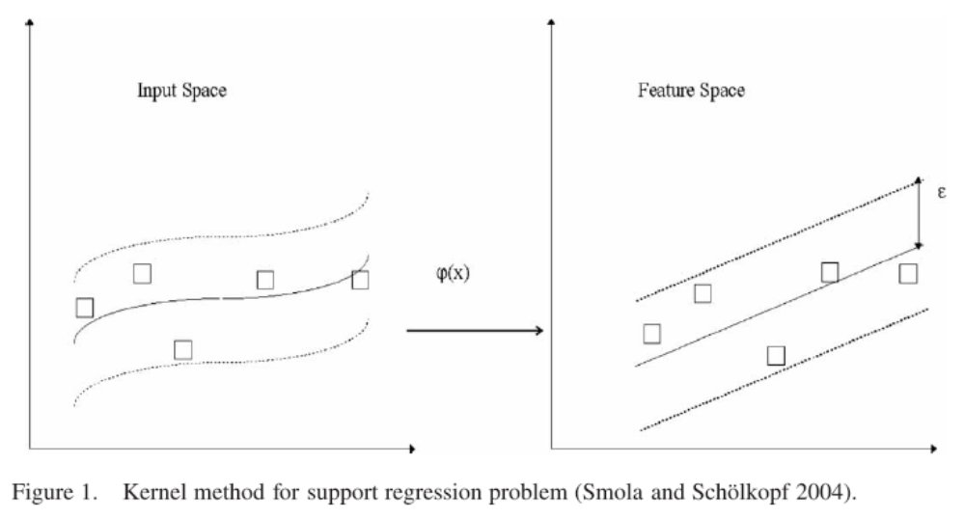
Support Vector Regression

Slide 7
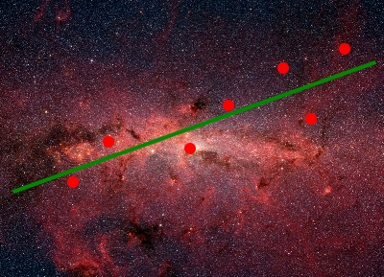
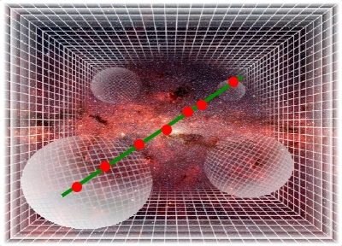
mapping

Slide 8
Support Vector Regression
To construct a hyperplane that lies “close” to as many of the data points as possible.
Developed by Vapink (1995)
Based on statistical learning theory
Based on the structural risk minimization (SRM, 結購風險最小化) principle
  Seeking to minimize an upper bound of the generalization error
  Rather than minimizing the empirical error.

Slide 9
Tendency forecasting
Use state variable
  Macroeconomic variable
  Fundamental analysis
    Price-to-earning
    Price-to-book
    Earning momentum
    …
  Technical analysis
    technical indicators
    dismisses fundamental variables, economic environment, industry trend and political events

Slide 10
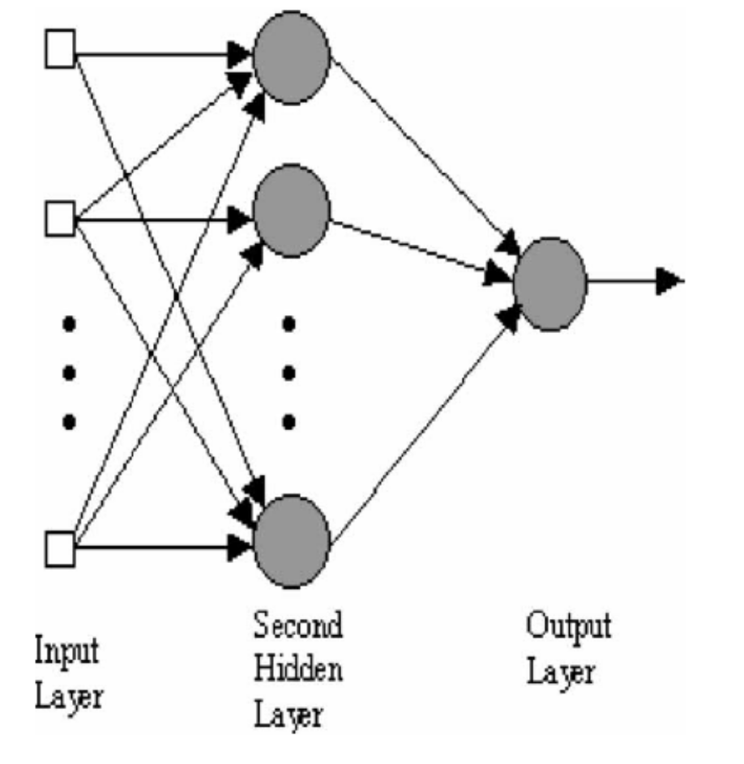
An MLP ANN architecture

Slide 11
Algorithm
Model – Data source
  The daily stock prices of ten companies traded in NASDAQ from 2000/1/1 to 2006/1/31.
  The training set contains 1300 observations.
  The testing / validation set consists of 200 examples

Slide 12
Algorithm
Model – Input indicators:
  Exponential moving average (EMA)
  Volume (V)
  Relative strength index (RSI)
  Bollinger bands (BB)
  Moving average convergence divergence (MACD)
  Chaikin money flow (CMF)

Slide 13
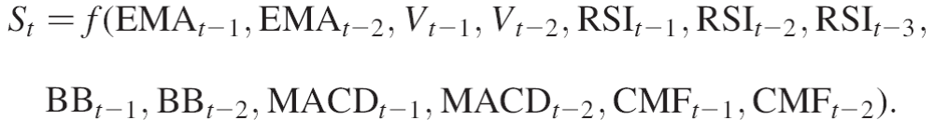
Algorithm
Model – Types: SVR, MLP, ARIMA
  First model type
  Second model type

Slide 14

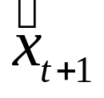
Algorithm
Strategy
  is the actual stock price at time t
  is the prediction of the stock price by SVM, MLP, ARIMA

Slide 15
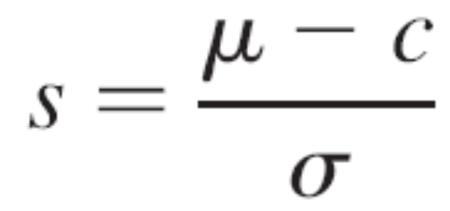
Algorithm
Strategy
  We assume there is no transaction cost
  The risk associated with these trading strategies is computed by using the Sharp ratio
  Sharp ratio is defined as excess return divided by a risk measure.

Slide 16
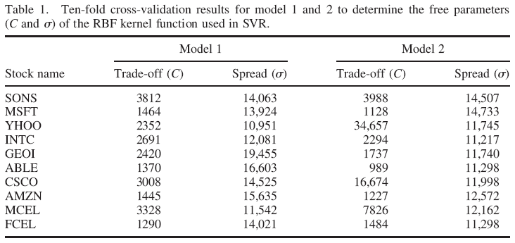
Ten-fold cross-validation results for model 1 and 2 to determine C and σ

Slide 17
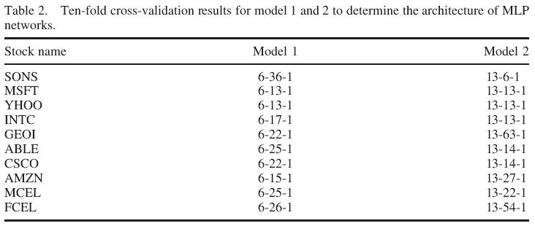
Ten-fold cross-validation results for model 1 and 2 to determine networks

Slide 18
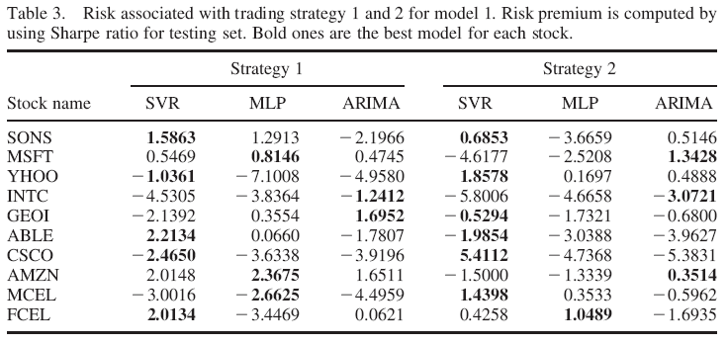
Risk associated with trading strategy 1 and 2 for Model 1
Average = -0.480 Standard deviation = 2.467

Slide 19
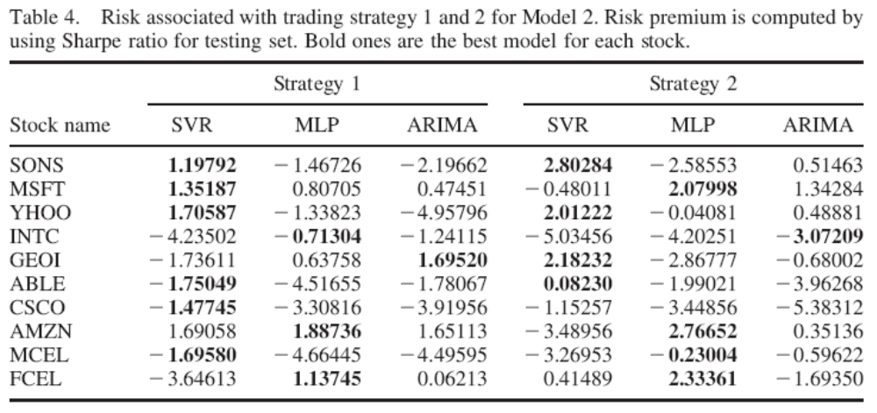
Risk associated with trading strategy 1 and 2 for Model 2
Average = -0.859 Standard deviation = 2.211

Slide 20
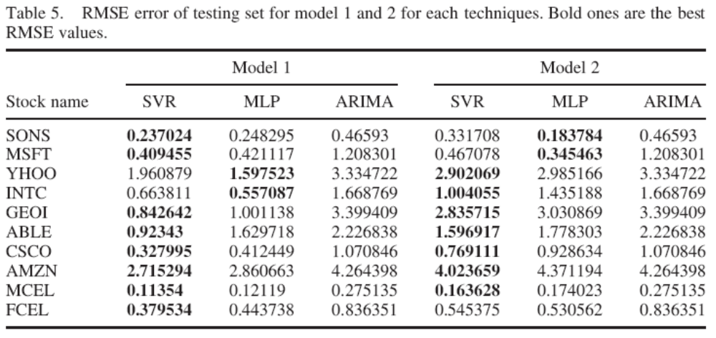
RMSE error of testing for model 1 and 2 for each techniques

